Slide 1








Team 16
Nguyễn Tống Minh
Lý Nhật Nam
Phạm Thanh Nam
Nguyễn Xuân Nam
- Package test
- Package sorting
- Class ArrayUtils
- UML Diagrams
- README.md
- Pull request feedback
- Package view
- Package controller
- Package listener
- Class ColorUtils
- Report writing
- Pull request feedback
- Class HomeScreen
- Class HomeController
- Class SortListener
- Package component (50%)
- Report writing
- Pull request feedback
- Package component (50%)
- Package exception
- Class DataUtils
- Presentation design
- Exception handler

Slide 2

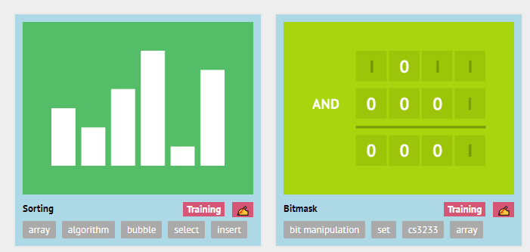
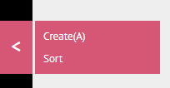
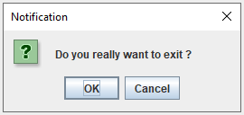
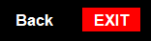
TOPIC :
Demonstration of sorting algorithms on an array
PROBLEM: Explain three sorting algorithms: Merge sort, Counting sort, Radix sort.
REQUEST: Visualize sorting algorithms on an array, making them become more intuitive
VISUALGO
Choice matter!
Some more options
Don't be too
FAST!

Slide 3

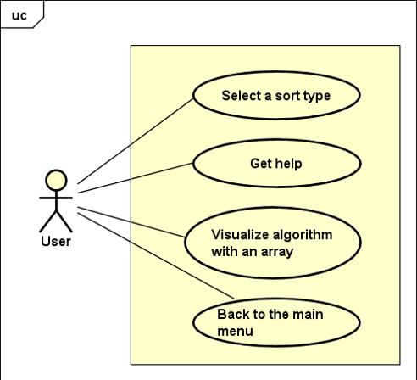
Use case diagram
- Select a sort of type: Allow the user to choose an algorithm to sort with an array.
- Visualize algorithms: GUI, run the designated algorithm, run/reset the visualization, see the steps in the sorting process,...
- View help menu: Show the user manual and application restriction to the user under.
- Back to the main menu: Backward to the main menu where to choose sorting algorithms.

Slide 4

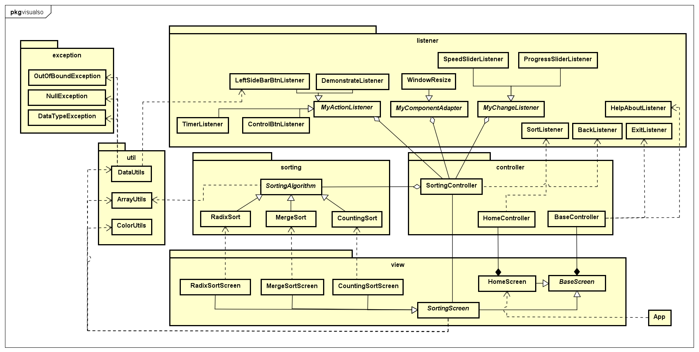
General class diagram

Slide 5
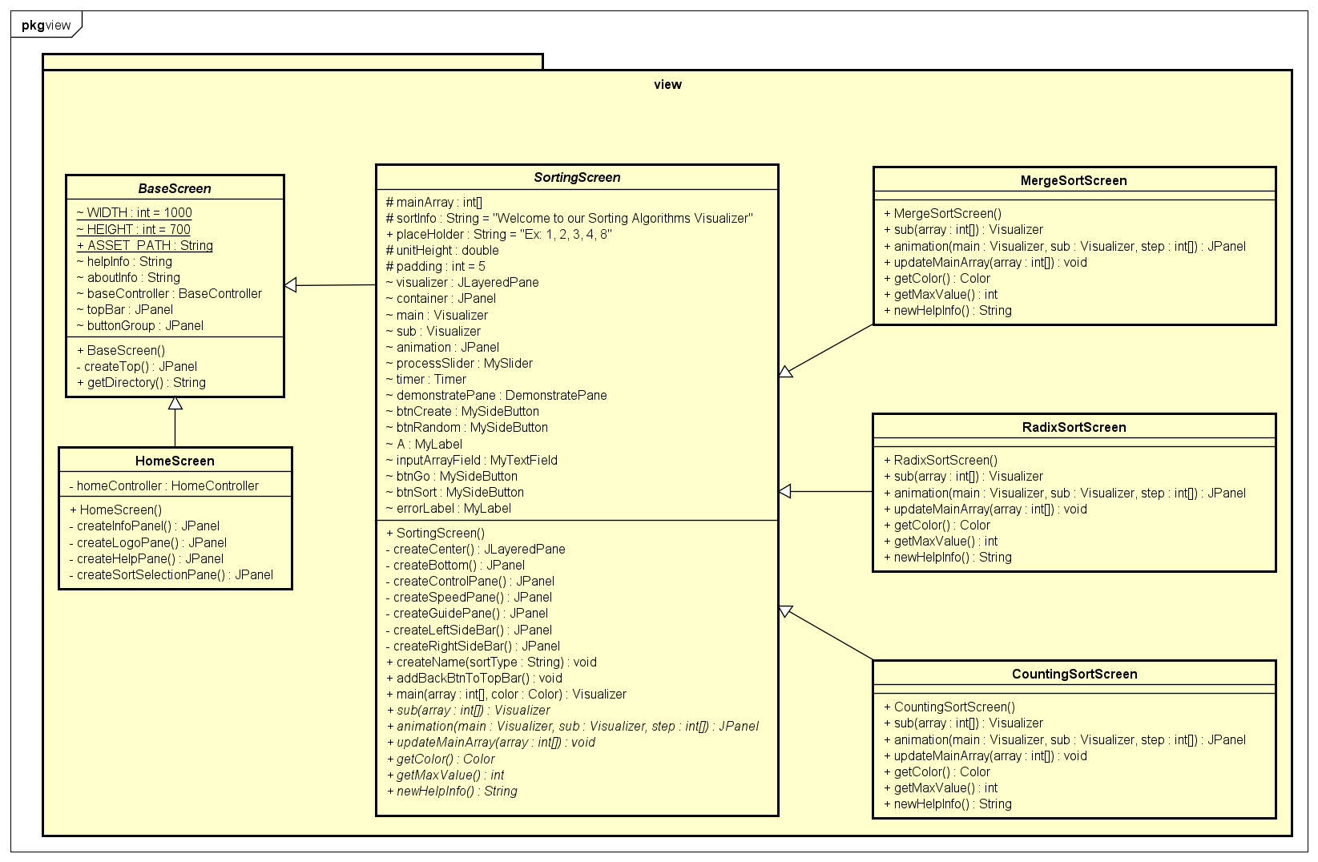


Package view
Package view

Slide 6
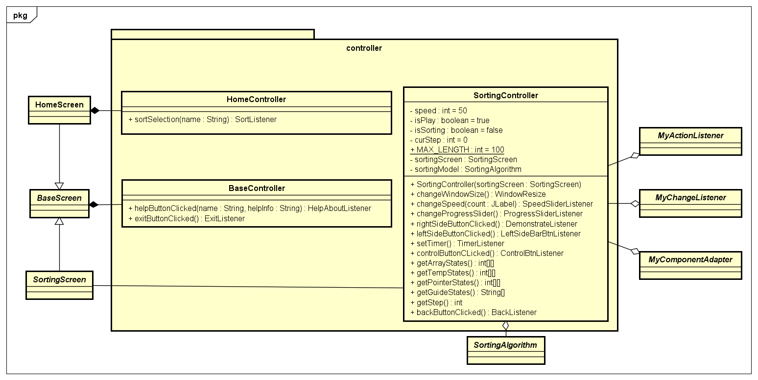
Package controller

Slide 7
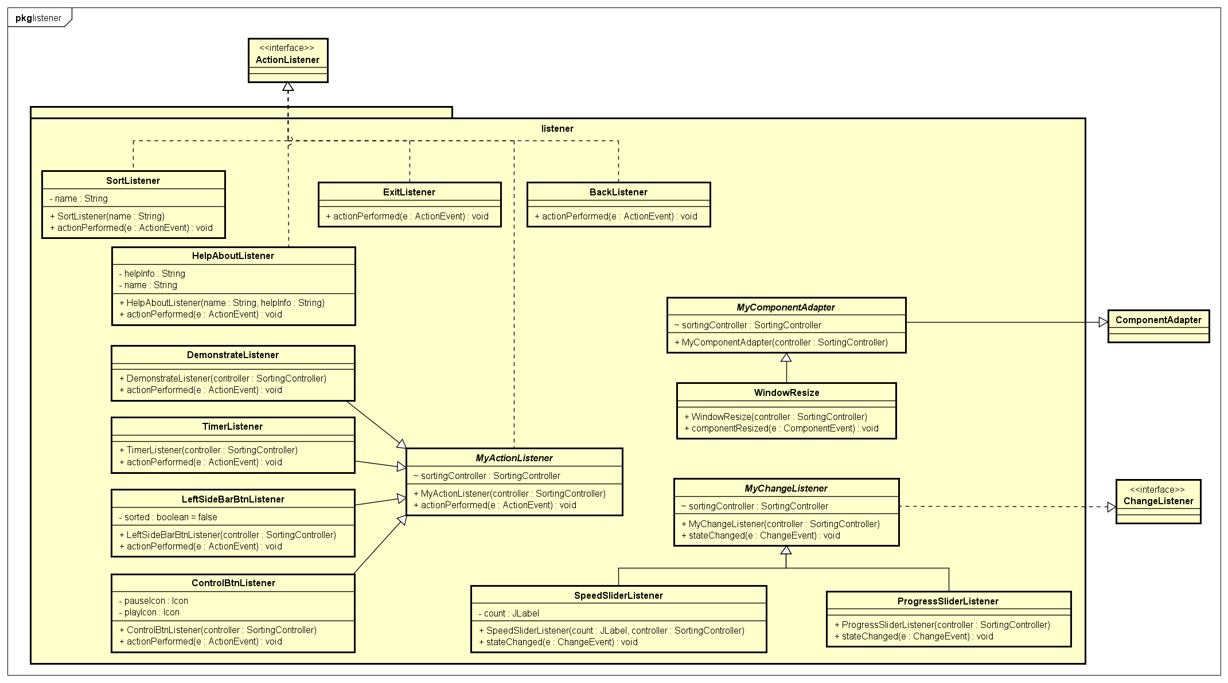
Package listener

Slide 8
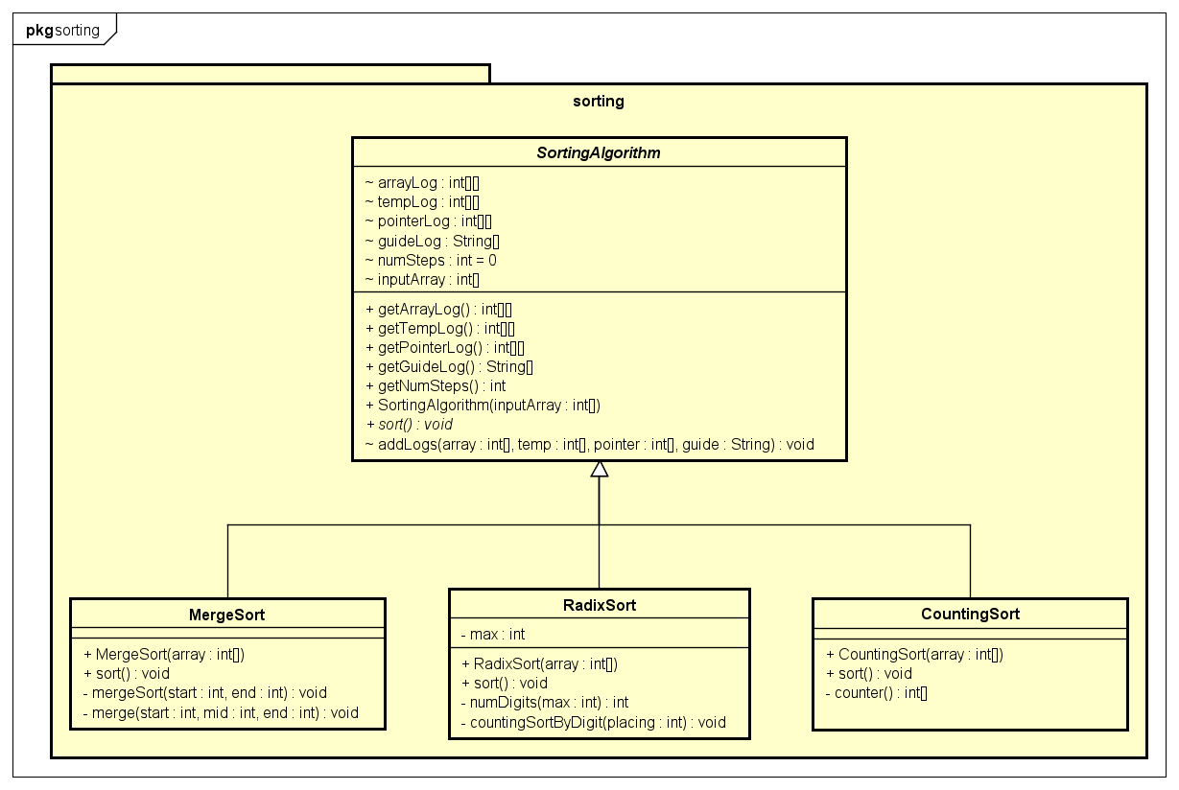
Package sorting

Slide 9
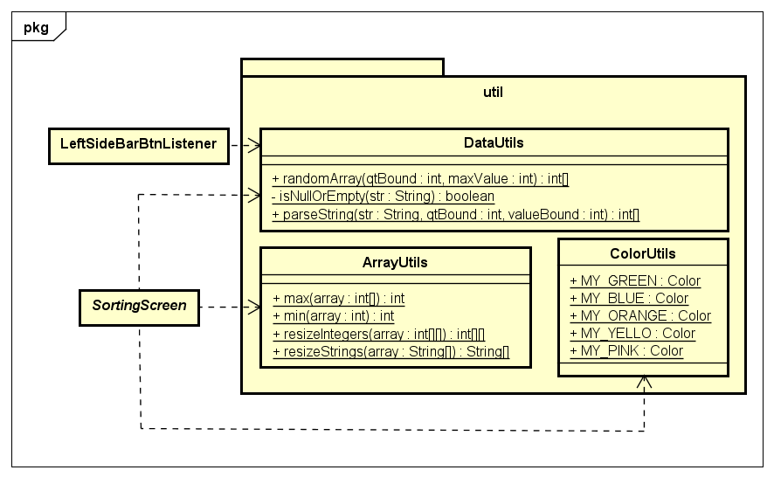
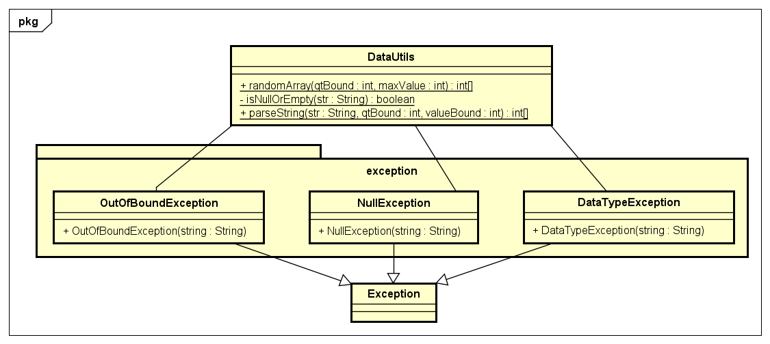
Package util
Package exception

Slide 10


OOP TECHNIQUES
01
02
Composition
Inheritance
- Has-a BaseController and BaseController fully dependent on BaseScreen
- Has-a HomeController and HomeController fully dependent on HomeScreen
-Has-a HomeController and HomeController fully dependent on SortingScreen
- HomeScreen inherit from BaseScreen
- Sortingscreen inherit from BaseScreen
- MergeSortScreen, CountingSortScreen, RadixSortScreen inherit from SortingScreen, SortingAlgorithm
- MyActionListener inherit from awt.ActionListener
- LeftSideBarBtnListener inherit from MyActionListener
- MyChangeListener inherit from awt.ChangeListener
- ProgressSliderListener inherit from MyChangeListener
-MyComponentAdapter inherit from awt.ComponentAdapter
- WindowResize inherrit from MyComponentAdapter
- NullException, OutOfBoundException, DataTypeException inherit from Exception

Slide 11
OOP TECHNIQUES
03
04
Polymorphism
Aggregation
- MergeSortScreen, CountingSortScreen, RadixSortScreen override method for each Screen
- LeftSideBarBtnListener overide actionPerformed
- ProgressSliderListener overide stateChanged
- WindowResize overide componentResize
- SortingController has-a sortingModel
- MyActionListener has-a sortingController
- MyChangeListener has-a sortingController
- MyComponentAdapter has-a sortingController

Slide 12
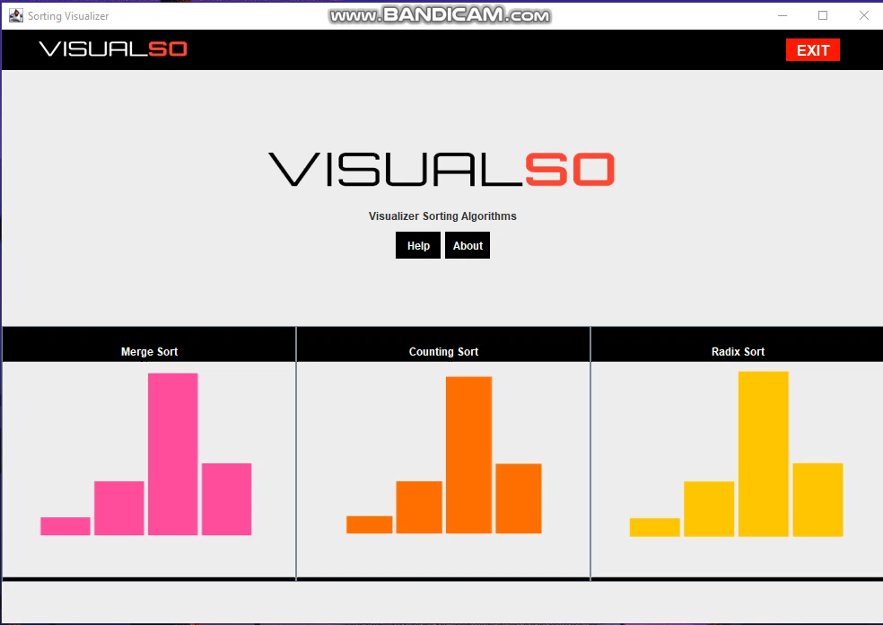
DEMO

